Slide 1
Optimization methods for the Problem of Team Composition
Names: Tal Oved, Elad Mandinach
Supervisor: Dr. Daniel Sigalov
Spring 2023

Slide 2

Introduction
Team Composition in Sports
- Importance of strategic team assembly
- Influence on game outcomes and tournament success
Complexity of Optimization
- Challenges in creating an optimal team
- Consideration of player skills, teamwork, strategy
Project Goal
- Develop a method for optimizing team compositions
- Addressing the NP-hard problem complexity

Slide 3
Composition Rules
- Individual athletes (male/female)
- Pairs of female athletes
- Pairs of male athletes
- Trios of female athletes
- Quartets of male athletes
- Pairs comprising one male and one female athlete

Slide 4

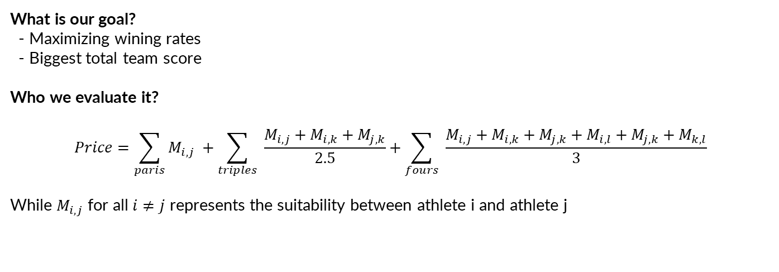
Evaluating solution
What is our goal?
- Maximizing wining rates
- Biggest total team score
Who we evaluate it?
$$Price=\sum_{paris}{M_{i,j}} +\sum_{triples}{ \frac{M_{i,j}+M_{i,k}+M_{j,k}}{2.5}}+\sum_{fours}{ \frac{M_{i,j}+M_{i,k}+M_{j,k}+M_{i,l}+M_{j,k}+M_{k,l}}{3}}$$
While $M_{i,j}$ for all $i≠j$ represents the suitability between athlete i and athlete j

Slide 5
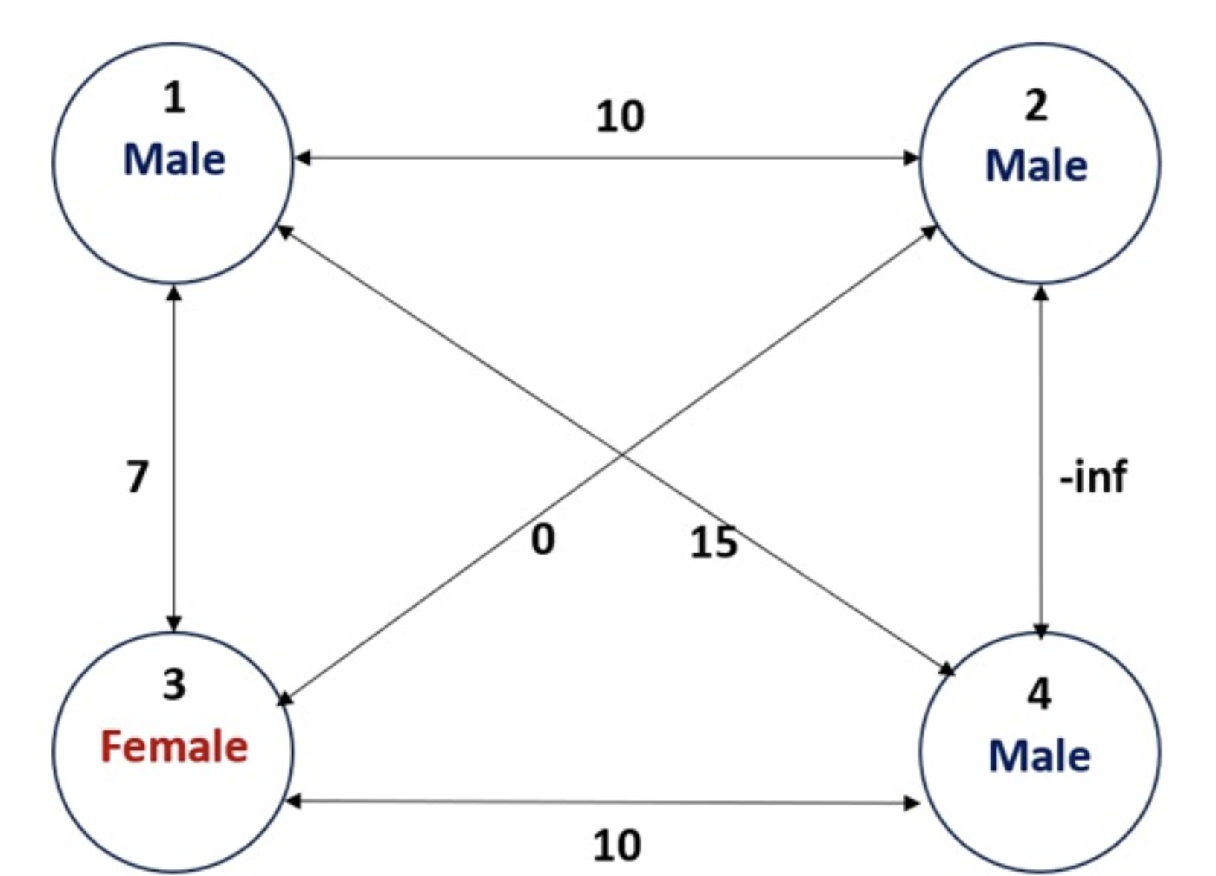
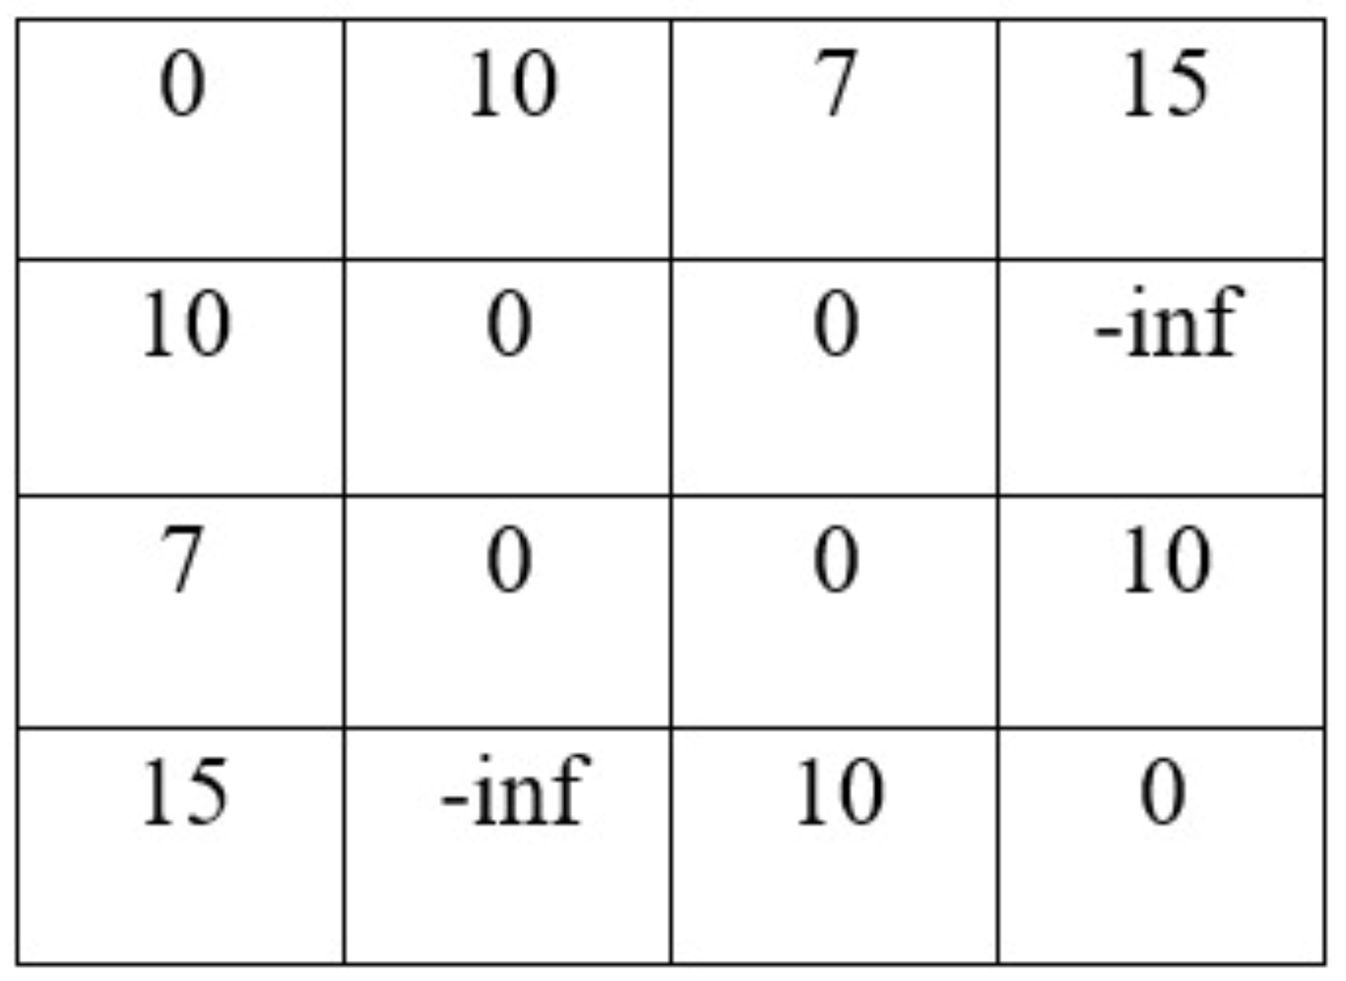
Problem modeling

Slide 6
Model’s solution
male
female
1
2
Score: 20
4
3

Slide 7
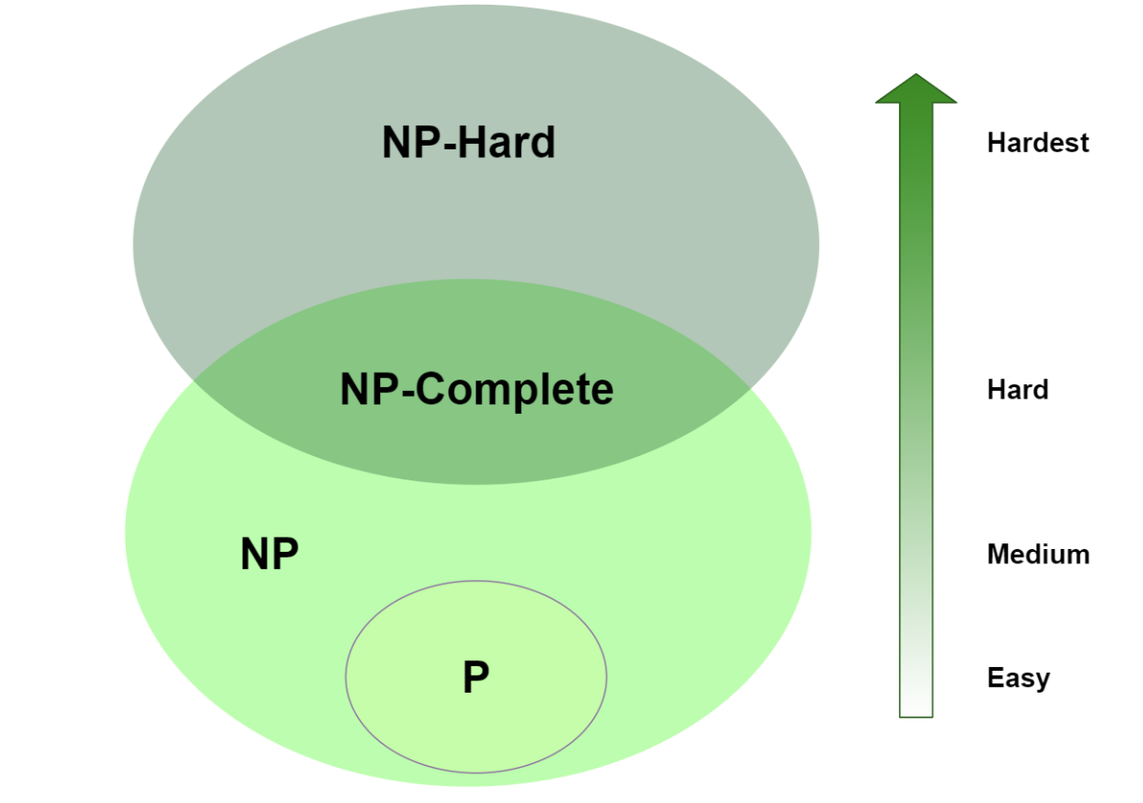
The NP-Hard Problem in Team Composition
What is NP-hard problem?
Challenges in Traditional Methods
Project Focus
- Addressing the complexity of team optimization
- Importance of advanced computational techniques

Slide 8
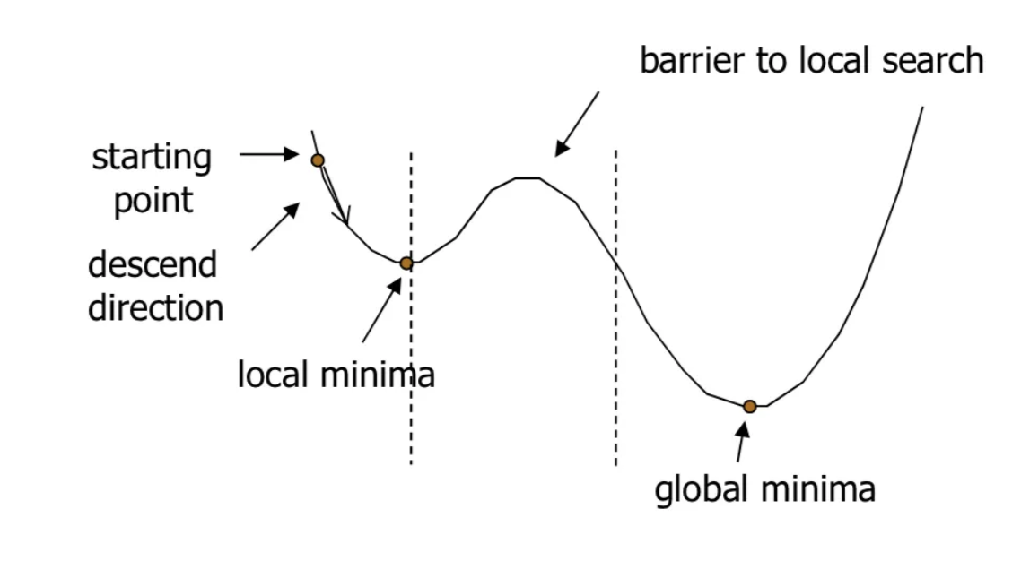
Our Approach to Solving the Problem
01
Simulated Annealing (SA)
02
Cross Entropy (CE)

Slide 9
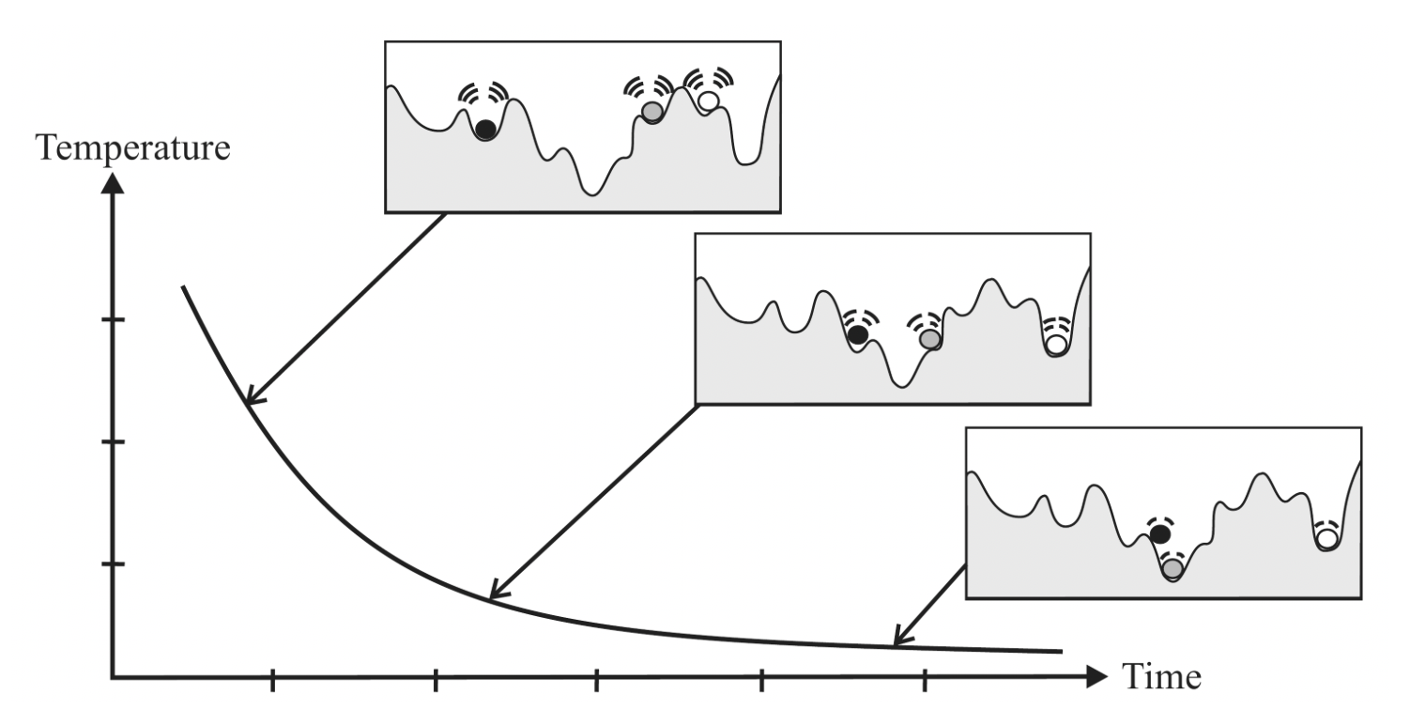
Deep Dive Into Simulated Annealing (SA)
SA Characteristics
- Adaptive search capability
Application in Project
- Adaptation of SA for team composition
- Specifics of algorithm implementation

Slide 10
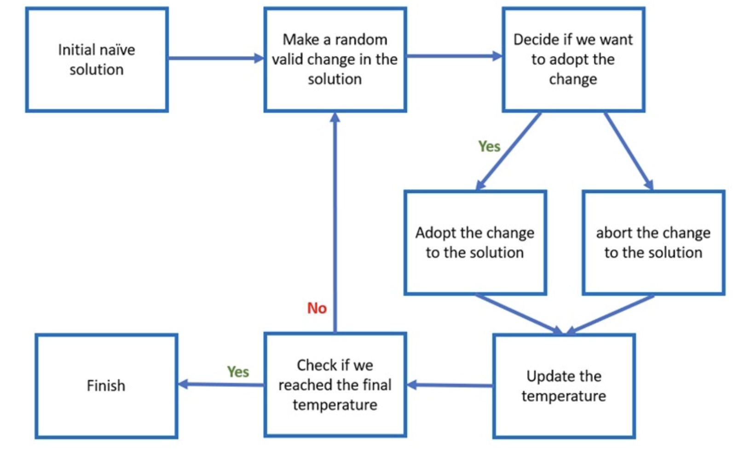

Slide 11

Important parameters
Initial temperature
Final temperature
Temperature reduction rate
Probabilities for creating a new team or making a double change in an iteration

Slide 12

Exploring The Cross Entropy (CE)
CE Characteristics
Implementation in Our Project
- Tailoring CE for specific challenges in team optimization
- How do we generate each solution? regressive approach
Implementation Challenges
- Why the CE is not fitting to our problem?

Slide 13
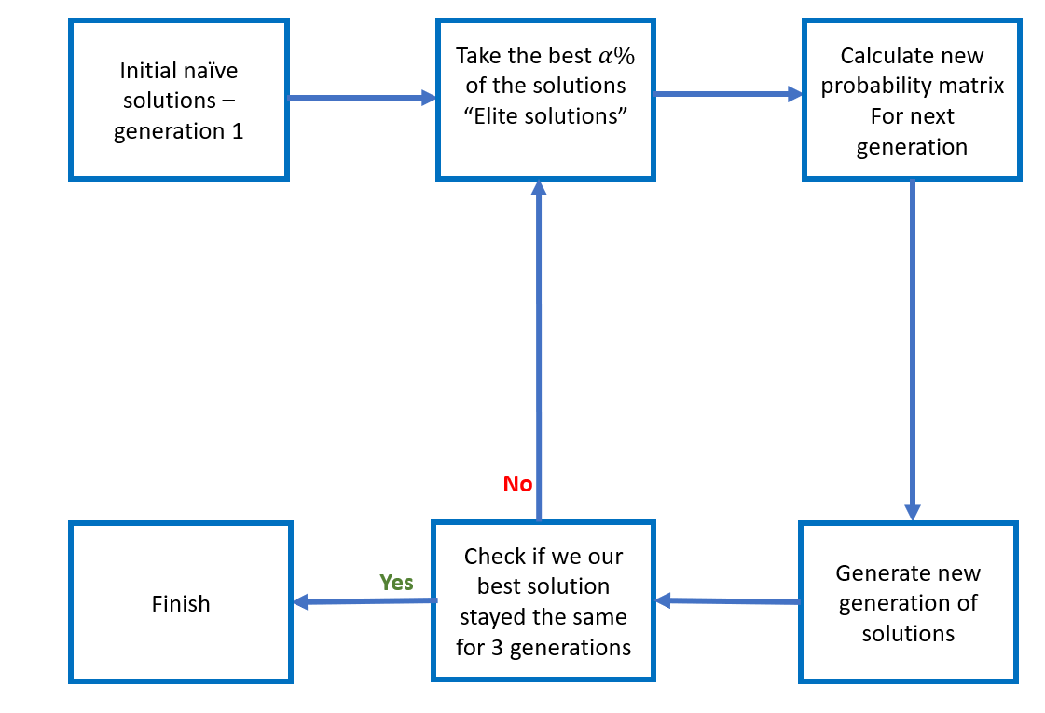

Slide 14
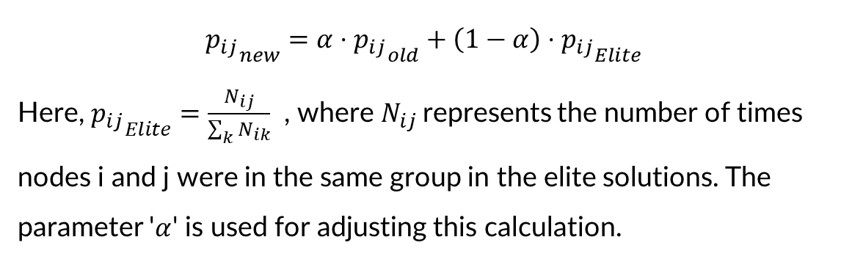
CE Next probabilty calculation
$${p_{ij}}_{new}=α⋅{p_{ij}}_{old}+\left(1−α\right)⋅{p_{ij}}_{Elite}$$
Here, ${p_{ij}}_{Elite}=\frac{N_{ij}}{\sum_{k}{N_{ik}}}$ , where $N_{ij}$represents the number of times nodes i and j were in the same group in the elite solutions. The parameter '$α$' is used for adjusting this calculation.

Slide 15
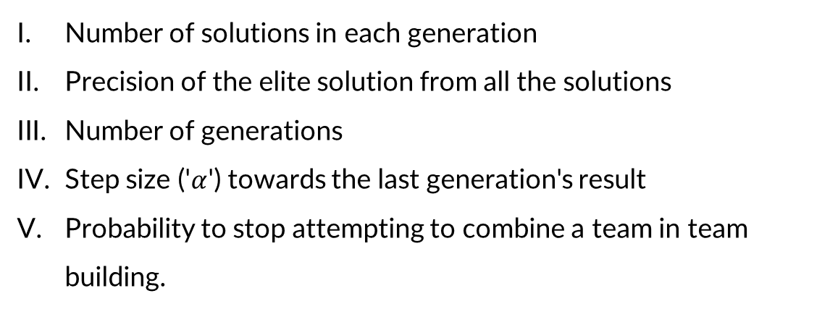
Important parameters
Number of solutions in each generation
Precision of the elite solution from all the solutions
Number of generations
Step size ('$α$') towards the last generation's result
Probability to stop attempting to combine a team in team building.

Slide 16
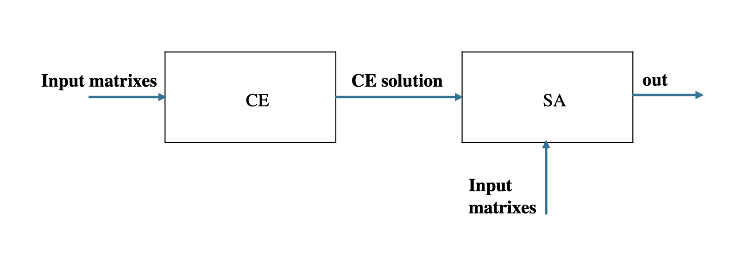
Combining simulated Annealing and Cross Entropy
Integration Strategy
- How SA and CE complement each other
- Implementation in the project
Enhanced Optimization
- Improved results with the combined approach
- Specific advantages in team composition optimization

Slide 17
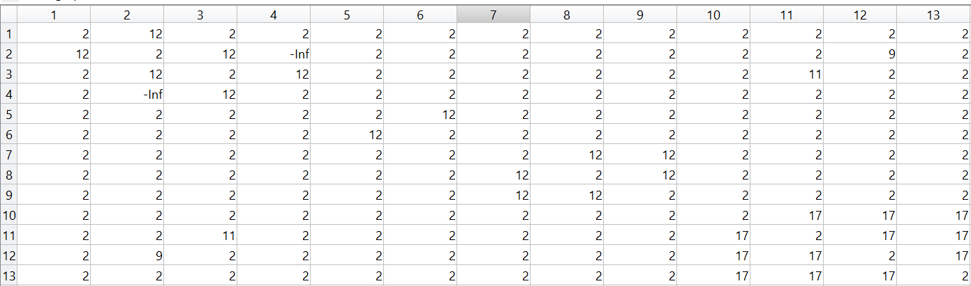
Example

Slide 18
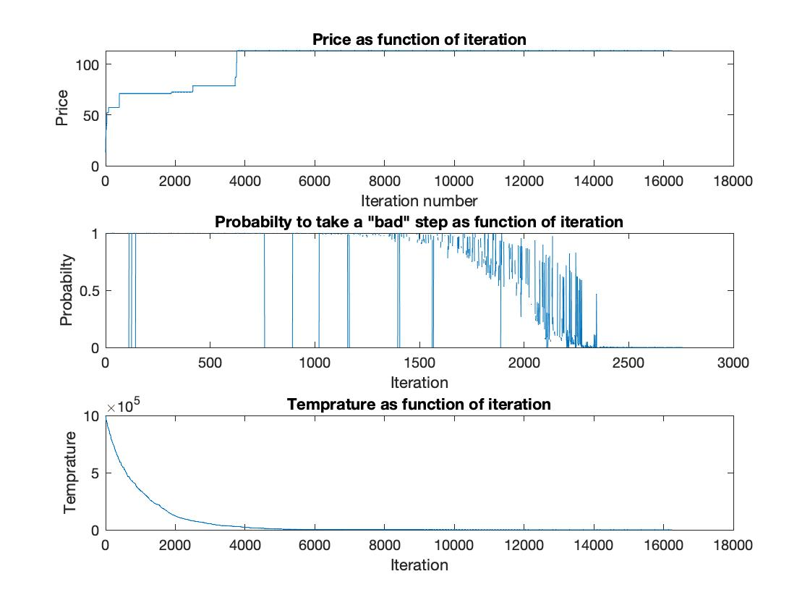
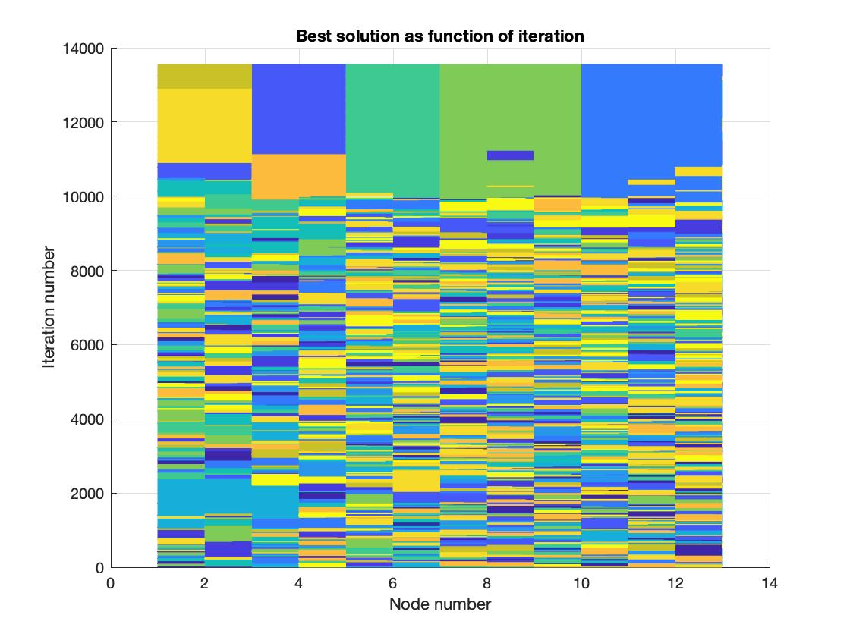
Convergence
SA
Team’s convergence
SA parameters and price as function of iteration
The different groups as function of iteration

Slide 19
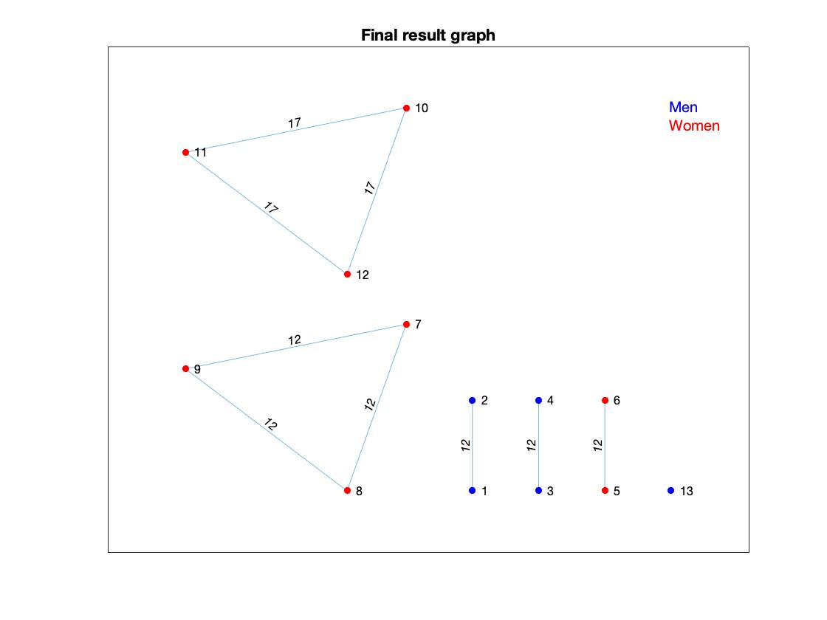
SA – final solution for our example
Score: 113.4

Slide 20
CE
No convergence (due to the regressive approach)

Slide 21
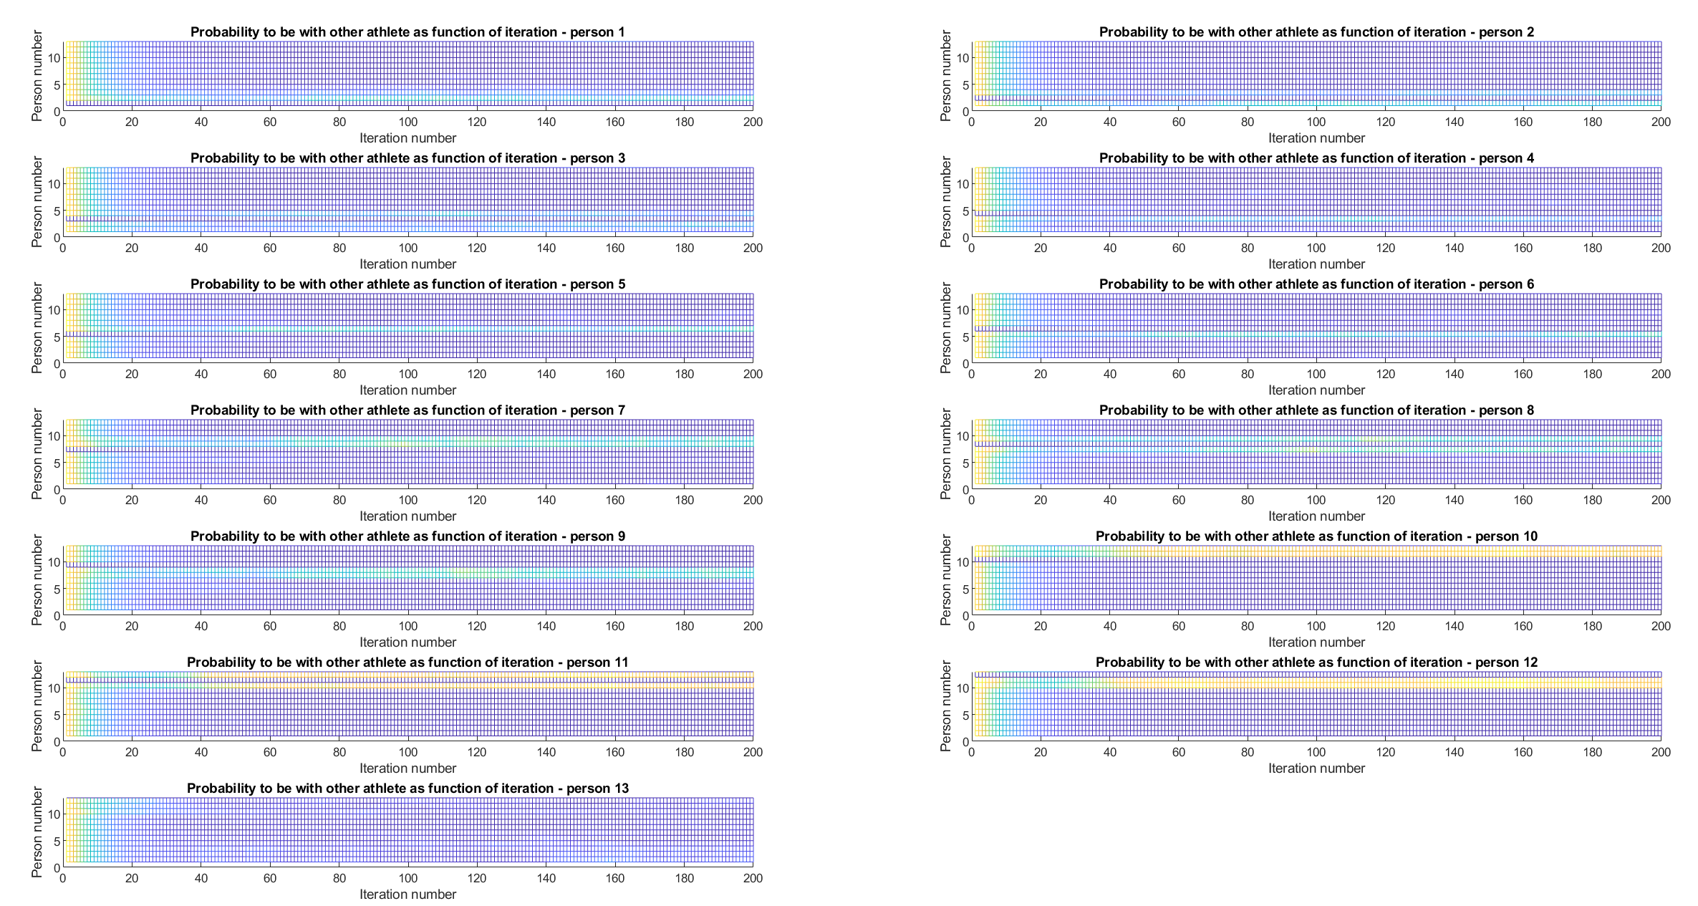
CE

Slide 22
CE – final solution for our example
Score: 107.4
(Taking the best solution in the last generation)

Slide 23

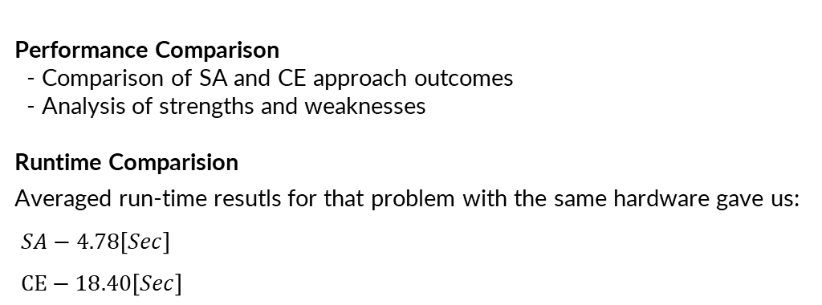
Results and Comparative Analysis
Performance Comparison
- Comparison of SA and CE approach outcomes
- Analysis of strengths and weaknesses
Runtime Comparision
Averaged run-time resutls for that problem with the same hardware gave us:
$SA−4.78\left[Sec\right]$
$CE−18.40\left[Sec\right]$

Slide 24
Robustness
The algorithm parameters have been fine-tuned for a problem involving a group size of 13 people.
But how big can our problem be for those parameters?
To assess the robustness of our algorithms across various group sizes, we conducted tests for different group sizes.

Slide 25
Robustness
Braking point

Slide 26

Conclusions
Achievements
- New algorithmic team composition solution
Practical Implications
- Real-world application in sports team management
- Potential influence on strategic decision-making
To be continue
- create adaptable optimisation algorithm
- create interface

Slide 27
References
A Tutorial on the Cross-Entropy Method
Pieter-Tjerk de Boer, Dirk P. Kroese, Shie Mannor, Reuven Y. Rubinstein,
September 2, 2003
http://l.academicdirect.org/Horticulture/GAs/Refs/Boer&others_2005.pdf
Simulation and the monte Carlo method
Reuven Y. Rubinstein, Dirk P. Kroese from WILEY-INTERSCINECE
Monte Carlo Book.pdf (dropbox.com)

Slide 28
Questions?

